Slide 1
Subject Languages
501 Information Organization and Access
Lecture
(With thanks to Emily Knox & Maria Bonn)

Slide 2
Agenda
Announcements
Subject Languages
Judging a Book by its Cover
Break
Reading Discussion
Pandoc Work Time
Takeaways
Next Week

Slide 3
What is the difference?
Genre analysis – what something is
Subject analysis – what is the material about?

Slide 4
Genre Analysis
Is vs. About

Slide 5
What? Genre analysis
Focuses on form and structure
From the reading:
Types:
Contests
Dramas
Actualities
Persuasions
Polarity
Emotive
Objective

Slide 6
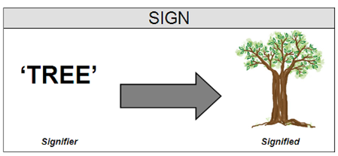
How? Signs, Signifier, Signified
Signifier – images, sounds
Signified – the concept
http://www.nocleansinging.com/tag/signified/
Notes:
Briefly discuss in-class exercise – will read the “signs” on covers
Saussure – there are different types but this is the most basic level
-remember that this is arbitrary and situated

Slide 7
Elements of Genre
Time
Location
Hero
Heroine
Secondary Characters
Villains
Plot
Theme
Costume
Locomotion
Weaponry

Slide 8
Formulaic Elements in Popular Genres
Genre | Western | SF | Spy
Time | 1800s | Future | Present
Location | Edge of Civilization | Space | World
Hero | Cowboy | Spaceman | Agent
Heroine | Schoolmarm | Spacegal | Woman spy
Secondary characters | Townsfolk, Indians | Technicians | Other spies
Villains | Outlaws | Aliens | Moles
Plot | Restore Law | Repel aliens | Find mole
Theme | Justice progress | Triumph of humanity | Save free world
Costume | Cowboy hat | High-tech | Suit
Locomotion | Horse | Spaceship | Planes
Weaponry | Six-gun | Ray gun | Pistol & silencer
Berger, A. ,Popular culture genres, p. 33

Slide 9
Genre and Formula
Authors play with the formula of a genre
Subgenres have slightly different formulas
Used to classify works but recall that people will have different typologies

Slide 10
Subject Languages
Thank you to M. Bonn for theSE Slides!

Slide 11
Tools and terms to be familiar with:
Controlled vocabulary
Thesaurus
Indexing
Folksonomies
Tagging

Slide 12
Ways of sorting
Ontology -Hierarchical and formal structuring of knowledge using a set of agreed upon concepts for a particular domain of interest. These are used to create a vocabulary that formally describes objects and the relations between them.,SEE: OWLSee also :dBpedia, FreeBase
Classification*- Organizational structure of entities or concepts, that explicitly expresses logical relationships between entities or concepts. Such organization is based on characteristics in common and those which distinguish them. DDC DDC1 LC SuDocs NLM
Taxonomy - The science of classification, including general principles by which objects and phenomena are divided into classes. Taxonomies are classifications created according to a pre-determined system (Linneaus) which can be used to provide a conceptual framework for discussion, analysis or information retrieval. Most often used on websites as a navigational structure of topics and sub-topics. GAMES
Thesaurus* - A tool used for vocabulary control – often used to improve search results. Used for indexing and retrieval. Often includes information about the relationships of words and phrases (BT NT RT) EXAMPLES NISO
Controlled vocabulary (CV)- Established lists of standardized terminology for use in indexing and retrieval of information for people (Authority files), places (gazeteers) and things (LCSH.
(Example: Subject headings lists*. LCSH SEARS MesH see also SAS)‏
Notes:
Commonalities: Begin with natural language/groupings of terms (varying structure)/importance of context
Ontology: A formal, explicit, specification of a shared conceptualization. An abstract model of the world that identifies relevant concepts of a given phenomenon. (Defining Types of concepts and constraints. Captures consensual knowledge. Contains:
(Basic or ground level) (Classes- sets of objects) (Attributes - characteristics of objects) (Relations - ways in which objects can be related to each other)‏
Types: organizational (meta-model of information), domain (content of the information source), enterprise (model business processes).
Classification: analysis of the relations+associations between/among objects
Bibliographic Classifications
Twofold application: arrange documents and arrange surrogates of documents
Arranging documents—assign single class number to enable collocation for shelf browsing
Arranging surrogates of documents—could assign more than one number (e.g., as is done in classified catalogs)‏
Features of Bibliographic Classifications
Verbal description of things and concepts that can be represented in or by the scheme
Arrangement of verbal descriptions in classed order
Notation alongside verbal description used to represent it and show order
4) Alphabetic index of terms used in schedules leading to notations, together with references to guide classifier and searcher to different aspects of a topic
Taxonomy: Classification, including the general laws and principles. Use classification and thesaural principles.
This term is being used in a variety of different ways:
Web directories,
Taxonomies to support automatic indexing (in which case the taxonomy is like a thesaurus enriched with algorithms of word and phrase sets, synonyms and syntactic variations and various weighing and instructional devices).
Filtering- a thesaurus formatted to enable navigation by browsing hierarchies and related terms.
Corporate taxonomies: used for inputting information, or in the display of search terms and results. Could also take the form of a high level map to an organization’s businesses, methods, guidelines and standards, people, and knowledge contents. This becomes a master scheme from which a range of tools (including thesauri) can be derived.
Thesaurus: A classified list of terms in a particular field for use in indexing or information retrieval. Often contains a controlled vocabulary used for indexing and retrieval. (search thesaurus) (vocabulary mapping or switching) (relationships – hierarchical, associative, equivalence). Similar to semantic networks but not dependent on the traditional use of cross references and scope notes. Semantic networks often go beyond conventional thesauri in defining the types of relations between terms. Labels for content description (classified list)‏

Slide 13
How? Subject Languages
Artificial languages designed for the purpose of retrieving information
Used to control vocabulary
Alphabetic [words]
Examples: Library of Congress Subject Headings, Sears List of Subject Headings, Thesaurus of ERIC Descriptors, Medical Subject Headings
Classification schemes [notations]
Examples: Dewey Decision Classification, Library of Congress Classification, National Library of Medicine Classification

Slide 14
Types of Bibliographic Classification
Universal schemes (but may reflect biases of compiler)
National general schemes (e.g., Sweden and the Netherlands)
Subject specific (e.g., National Library of Medicine; ACM)
Homegrown
BISAC (book industry categories)

Slide 15
A general question
Which works better:
Look at the objects and then design the scheme?
Design the scheme and then fit the objects into it?
If 2. then what happens when an object doesn’t fit?
Notes:
Hyperlink to recent LOC Editorial Meeting to consider changes to LCSH and classification.

Slide 16
Alternatives
Natural language indexing –derived term systems (computers)
Folksonomy / tagging (users): personal and participatory
Authors may also index their works using any of these methods (do authors know best?)

Slide 17
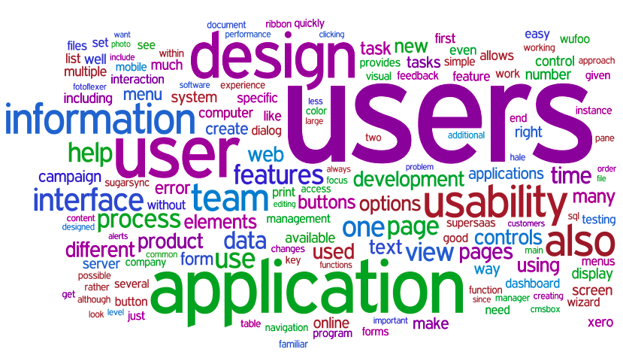
Natural language indexing
Tag cloud: display of tags using visual cues, like size, color and proximity to indicate importance or relationships

Slide 18
Folksonomies
Tag: single word or phrase assigned by users
Folksonomy: collective groupings of tags assigned by aggregate of users
Objects tagged can include: web pages, digital photos, physical objects represented by digital records (books, museum objects)

Slide 19
Folksonomies (cont.)
What is the nature of this “indexing language”?
Linguistic features (spelling, neologisms)
Relation between tag and text of the tagged resources
Function—subject-related vs. non-subject related (affective, time and task related)
How best to display terms to aid searching?
Tag cloud vs. traditional search interface
Tag clouds support browsing or serendipitous discovery?
Harnessing the power of the crowd?

Slide 20
Roles of Controlled Vocabularies
Allow an indexer to represent the subject matter of documents in a consistent way
Bring the vocabulary used by the searcher into coincidence with the vocabulary used by the indexer
Provide means whereby a searcher can vary a search strategy in order to achieve better results (by exploring broader, narrower, and/or related terms)

Slide 21
Pre-coordination
Word string built at time of indexing using rules of controlled vocabulary
Railroads—Electric equipment —Maintenance and repair
Children as inventors

Slide 22
Post-coordination
Terms put together by user at time of searching
Railroads AND Electric equipment
AND Maintenance and repair
Children AND Inventors

Slide 23
Classification
DDC Relative Index entries: Distance education
300 Social Sciences
370 Education
371 Schools and their activities
371.334 Computers
[teaching aids, equipment, materials]
371.3331 Radio [teaching aids, etc.]
371.3358 Television [teaching aids, etc.]
371.35 Distance education
[methods of instruction and study]
374 Further Education
374.4 Distance Education/Adult level [adult education]
378 Higher Education
378.175 Higher education [methods of instruction and study]

Slide 24
Subject Headings (LCSH)‏
Distance education (May Subd Geog)‏
[LC 5800-LC5808]
Used for/See from: Distance learning
Here are entered general works on the various forms of supervised study usually in the field of adult education, supported by tutors and an organization at a distance from the student communicating via written, audiovisual, or electronic media
BT Education
RT Open learning
Telecommunication in education

Slide 25
LCSH (DE) continued
NT Copyright and distance education
Correspondence schools and courses
Libraries and distance education
Telephone in education
Television in education
University extension
--Law and legislation
BT Educational law and legislation
Distance education and copyright
USE Copyright and distance education

Slide 26
Lets talk about poetry
Dewey on poetry
LOC on poetry
The MLA Bibliography on poetry
ERIC on poetry
The Web on poetry?

Slide 27
Classification Theory
Beghtol: “Classification theories and the systems they give rise to are cultural artifacts that directly reflect the cultural concerns and contexts in which they are developed.”
Criticisms of classification:
National bias
Cannot characterize multitopical works
Obsolescence
Not understandable to library users

Slide 28
Library of Congress standards
Negroes as businessmen
Yellow peril
Homosexuality with see references to sexual perversion
Vietnam war - still just a conflict
Change comes from pressure (Berman and other activists).
“But in the realm of headings that deal with people and cultures--in short, with humanity--the LC list can only "satisfy" parochial, jingoistic Europeans and North Americans, white-hued, at least nominally Christian (and preferably Protestant) in faith, comfortably situated in the middle and higher income brackets, largely domiciled in suburbia, fundamentally loyal to the Established Order, and heavily imbued with the transcendent, incomparable glory of Western civilization.”
Sanford Berman. Prejudices and Antipathies, 1971

Slide 29
Judging a Book By Its Cover

Slide 30
Judging a book by its cover: Part 1
You will be shown a slide with 8 covers.
Get into small groups (2 to 3)
Pick two covers to discuss with your group
Answer the following questions:
What is the genre of the work?
What clues does the cover give for deciding on the genre?
Notes:
You might want to use the GSAFD – Guidelines to Subject Headings for Fiction and Drama

Slide 31

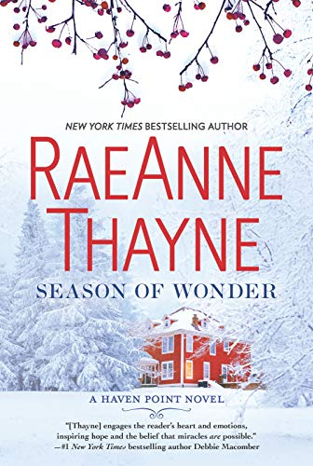



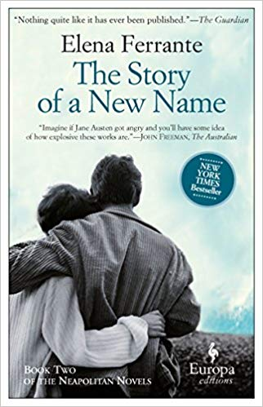


Notes:
Cheat sheet
Season of Wonder – Romance Fiction, Domestic Fiction, Single mothers Fiction
The Dearly Beloved - Married people fiction, Christians Fiction, Autistic Children fiction,
Beneath a Scarlet Sky – World War, Spy Stories, History
Nothing more dangerous – Missing persons fiction, racism fiction, historical fiction
Call down the hawk – Dreams fiction, Magic Fiction, YA fiction, Fantasy
The story of a new name - Female friendship fiction, Marital conflict, self-perception in women fiction
Tailspin – Air pilots fiction, Suspense fiction, Romantic suspense fiction
A Christmas Gathering – world politics fiction, mystery fiction, traitors fiction

Slide 32
Judging a book by its cover: Part 2
Be sure to keep a site and users in mind as you complete this part of the exercise.
Pick two books from the list.
Using the steps in Organization of Information Appendix A (reading), analyze the subject of the item.
Apply 2 -3 LCSH (http://id.loc.gov/authorities/subjects.html) to the item
Look up the book on WorldCat. Did your group use the same subject headings? Do you think the subject headings on the record are adequate for your site and users? Would you add more? Take some away?
Report your genre and subject analyses to the class.

Slide 33
Reading Discussion
How should information professionals define genre?
What should be the role of folksonomy is professional cataloging?
How should we organize fiction?
How often should we reorganize fiction?
Who has a harder job catalogers in libraries or archives?
Why do we love acronyms so much?

Slide 34
Takeaways

Slide 35
Next Week: Issues in Description (Naming and Power)
Final Assignment Sample Annotation Due
Adler, M., Huber, J. T., & Nix, A. T. (2017). Stigmatizing disability: Library classifications and the marking and marginalization of books about people with disabilities. Library Quarterly, 87(2): 117-135.
Bullard, J. (2017). Warrant as a means to study classification system design. Journal of Documentation, 73(1), 75-90.
Howard, S. A.; Knowlton, S. A. (2018). Browsing through bias: The Library of Congress Classification and Subject Headings for African American studies and LGBTQIA studies. Library Trends, 67(1): 74-88.
McElroy, K.; Bridges, L. M. (2018). Multilingual access: Language hegemony and the need for discoverability in multiple languages. College & Research Libraries News, 79(11).
Suggested Readings:
Albarillo, F. (2016). Evaluating language functionality in library databases. International Information & Library Review, 48(1): 1-10.
Cerbo, M. A. (2011). Is there a future for catalogers? Cataloging & Classification Quarterly, 49(4): 323-327.
Dooley, J. (2015). The Archival Advantage: Integrating Archival Expertise into Management of Born-digital Library Materials. Dublin, OH: OCLC Research. Retrieved from http://www.oclc.org/content/dam/research/publications/2015/oclcresearch-archival-advantage-2015.pdf

